Slide 1

Cobblestone Tutor Bot
Online Learning Enhancement Tool
Adhithya Rokhith Bhaskar

Slide 2

Index
1. Understanding our Students
Different Student Profiles
Target Segment
2. Introducing our GPT Bot
A Demo – Our Bot
Design of our Bot
3. Objectives
Business Objectives
Detailed Personalized Objectives
4. Insights
Cost & Revenue Analysis
Potential Risks & Mitigation Plans
5. Features and Impact
Inside Features
Business Impact
6. Next Steps
Recommendations
Further Services

Slide 3

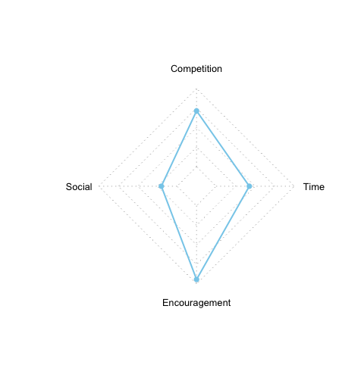
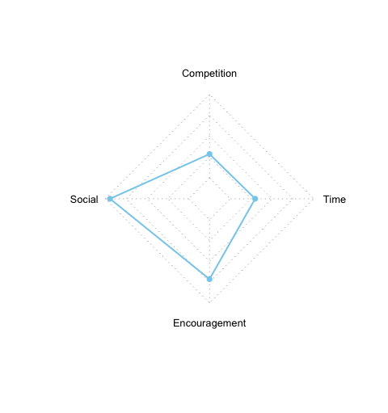
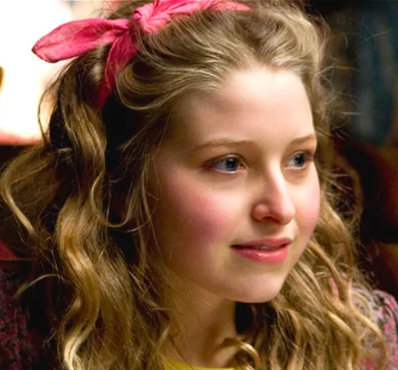
Different Student Profiles from Survey - I
Positive Player
Student Description
Game oriented and Highly Competitive
Shows positive signs towards encouragement
Socially not as forward as other segments
Has low affinity towards time management
❤️
🚫
Neighborhood Honey
Socially most active Student Profile
Shows positive signs towards encouragement
Dislikes Game and Competition
Has low affinity towards time management
❤️
🚫

Slide 4
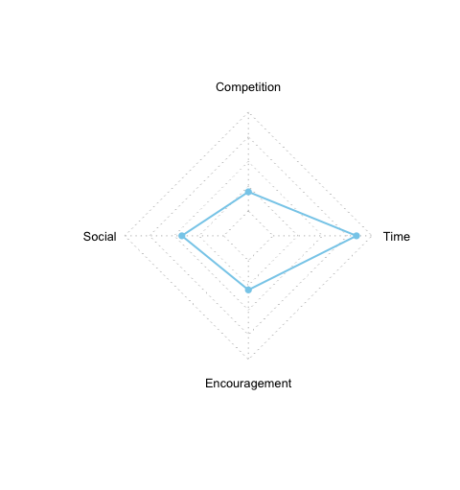
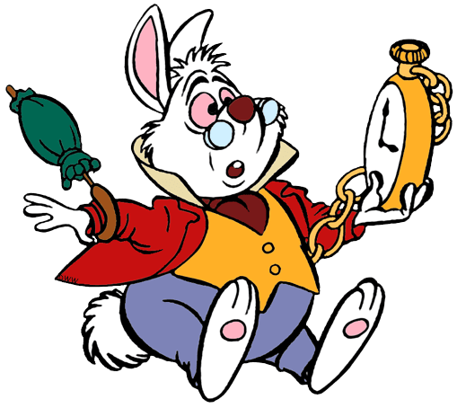
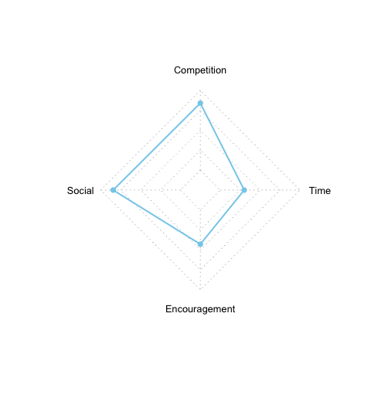
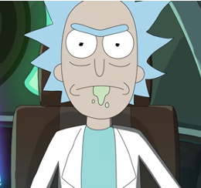
Different Student Profiles from Survey - II
Reserved Planner
Student Description
Relatively Sociable Student segment
Highly focuses on Time Management
Dislikes Games and not Competitive
Doesn’t show positive impact on encouragement
❤️
🚫
Popular Gamer
One of the Socially most active Student Profile
Strong affinity towards games and Competitions
Not great with Time Management
Has lesser impact with encouragement
❤️
🚫

Slide 5

Our Target Segment
Characteristics
Prefers Structured Learning
Thrives in Collaborative Learning Setting
Avoids Competitive Academic Landscapes
Appreciates Feedback but not through Encouragement
Reserved Planner

Slide 6
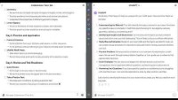
Introducing Cobblestone Tutor Bot vs ChatGPT Responses
CTB responds faster thus respecting the time of our Student Segment.
Asks questions to understand where the student is coming from.
Not overtly encouraging but responds with affirmation when student is less confident to boost their morale
Plans are tailored for the student’s requirements with the specifics
Stays away from pushing for Games or Competitions for our chosen target segment
Click to Explore the Bot Further
Click here if you can’t play the above video

Slide 7


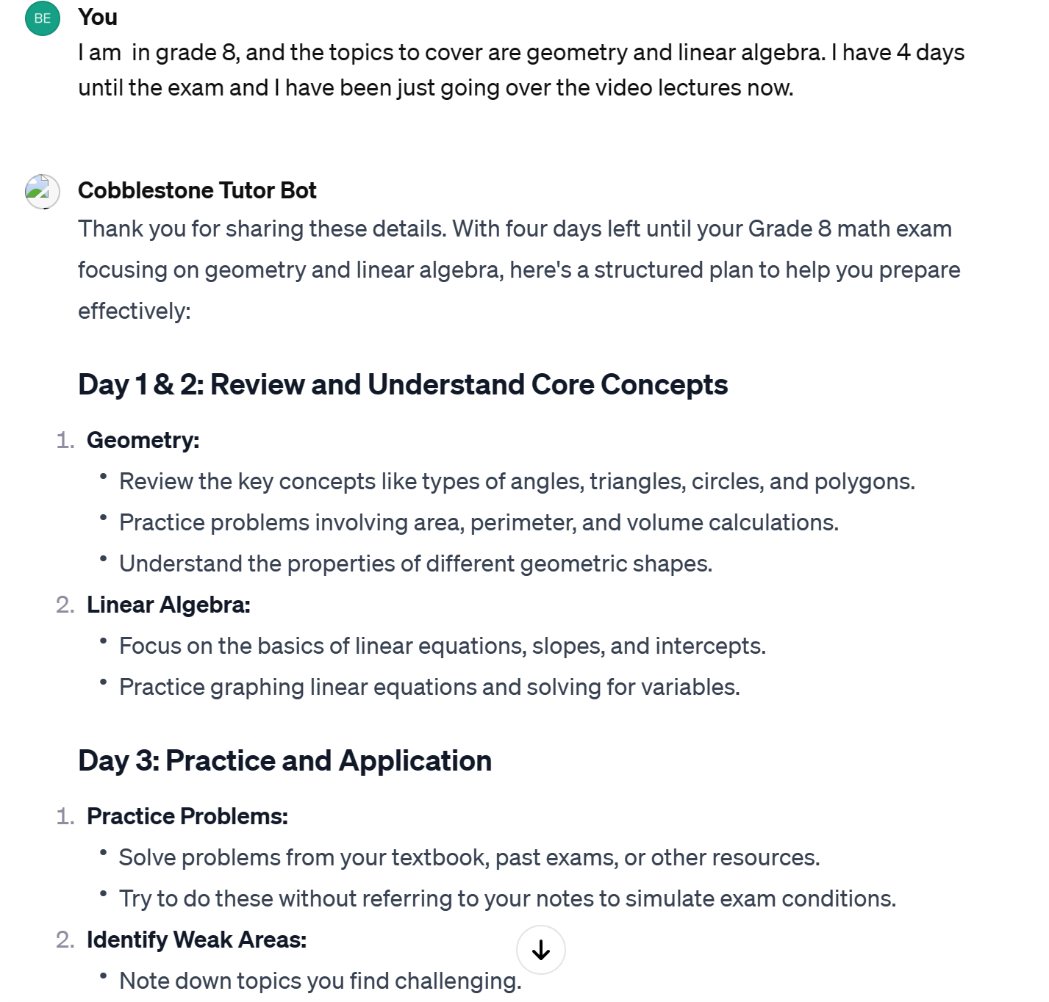
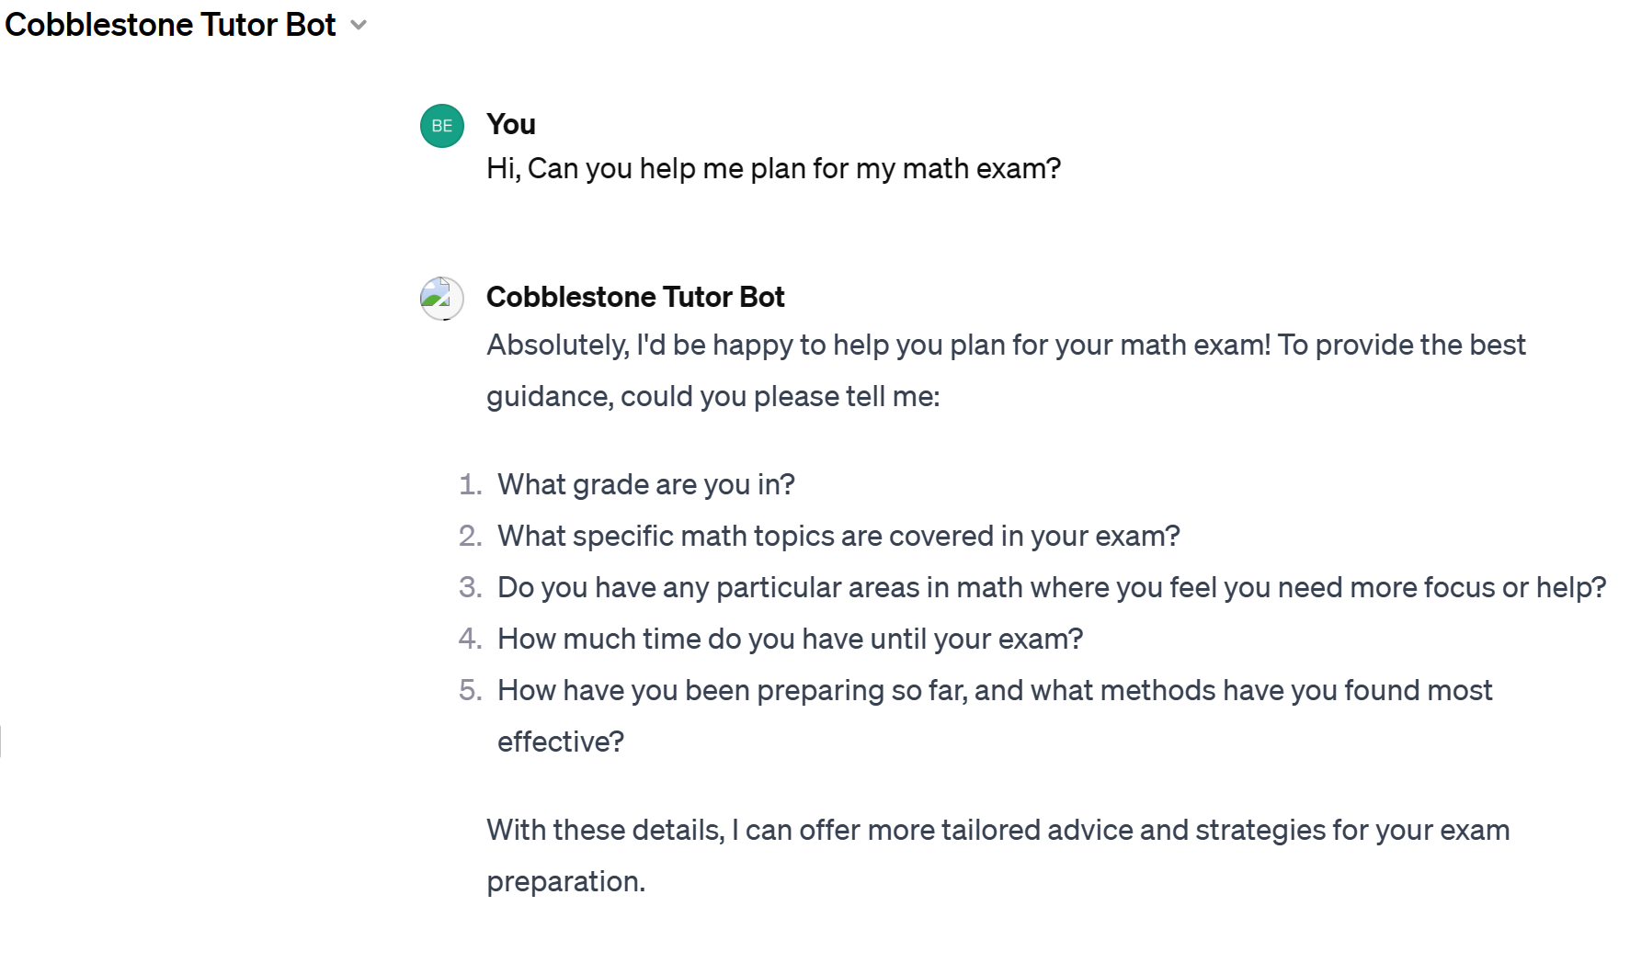
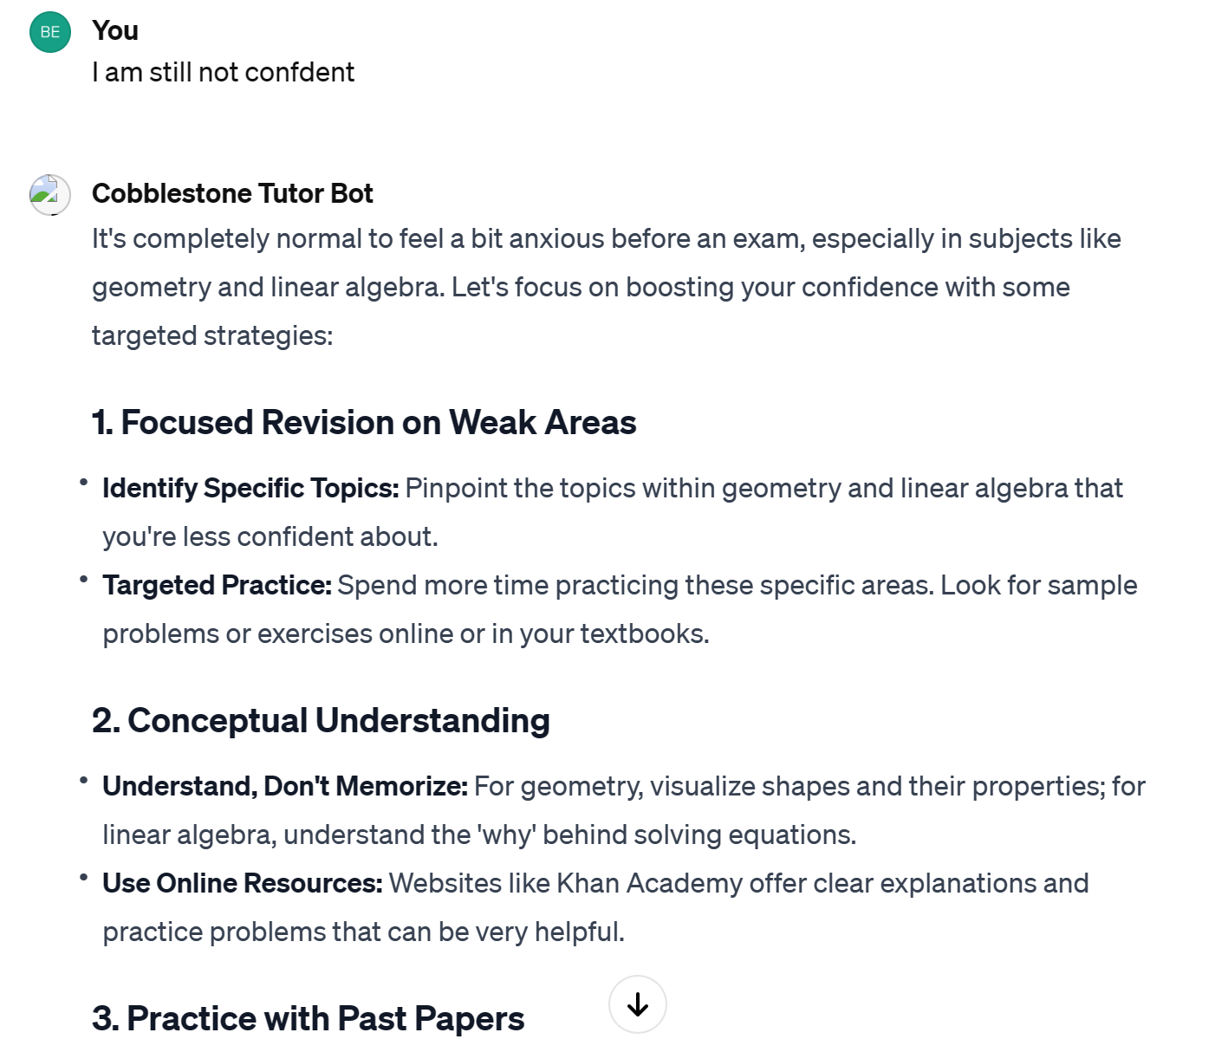
Design of our Bot
Interacts with students to learn from them and curate responses
Targeting a segment that manages Time very well with detailed yet concise responses with faster response time
Even though the Segment doesn’t respond well to encouragement, it keep a convincing subtle tone to boost the morale

Slide 8

Business Objectives
Advanced Online Learning: Introduce a GPT-based tutor chatbot to revolutionize test preparation and educational services.
Offer Personalization: Customize the chatbot to tailor it to the unique learning styles and needs of students as identified through extensive market research .
Ethical AI: Ensure the chatbot adheres to high ethical standards, particularly concerning student data privacy and unbiased responses.
Leading Innovation in Education: CLC aims to establish itself at the forefront of educational innovation and responsible AI usage.
Proactive Risk Management: Develop strategies to address potential risks associated with AI implementation in education

Slide 9

Personalized Objectives for the Chosen Segment
Facilitating Efficient Time Management (High T): Given their high T attribute, the chatbot should help users organize their schedules and optimize their study time.
Promoting Social Interaction (High S): With a high S attribute, the chatbot should encourage collaboration and networking among peers.
Minimizing Competitive Pressure (Low G): Addressing their low G attribute by providing a learning environment that de-emphasizes competition.
Streamlining Information Access: The chatbot should offer quick and easy access to information, considering their disposition towards efficient time management.
Customized Learning Pathways (low A): Aligning with low A tendencies, the chatbot should provide personalized learning experiences focusing on knowledge and skill acquisition rather than scores or rankings.

Slide 10




Development Cost
Cost Analysis
Licensing costs (ChatGPT)
Development and Design costs
Operational Costs
Costs to train the team
Maintenance costs
Indirect Costs
A Cost Perspective to the Chatbot
Cost to support potential increase in Support
Time Investment for monitoring and Updating it

Slide 11




Direct Revenue
Potential subscription fees if offered as a part of premium
Potential Increase in enrollments in the future
Revenue Analysis
Indirect Revenue
Cost savings from automating responses that would otherwise require human interaction.
Maintenance costs
Long Term Revenue
Data and insights gained from chatbot interactions can inform business strategy and product development.
Enhanced reputation and brand loyalty which can lead to word-of-mouth referrals.
A Cost Perspective to the Chatbot

Slide 12



Potential Risks
Technical Risks
Security & Privacy
User Adoption
Integration Issues: Difficulty integrating the chatbot with existing systems and platforms.
Scalability: Challenges in scaling the chatbot to handle a large number of users simultaneously.
Reliability: Risks of downtime or performance issues affecting user experience.
Data Breaches: Unauthorized access to sensitive student data.
Compliance: Failure to comply with data protection laws
Misuse of AI: Potential for the chatbot to be used for unintended or unethical purposes.
User Resistance: Lack of acceptance or resistance to using the chatbot from students.
Change Management: Inadequate support and training for teachers adapting to the new system.

Slide 13
Mitigating Risks and Privacy Concerns
Security & Privacy
Data Breaches: Remove the sensitive student information from the document intended to upload to Gen AI.
Compliance: Understand the users’ privacy laws before proceeding, hire law professionals to protect data privacy rights if needed while scaling up.
Misuse of AI: Set up clear boundaries and premises with Chatbot before further use. Monitor the prompts and responses for misuse.
Encryption: Implement encryption to Chatbot to prevent ourselves from being hacked.

Slide 14
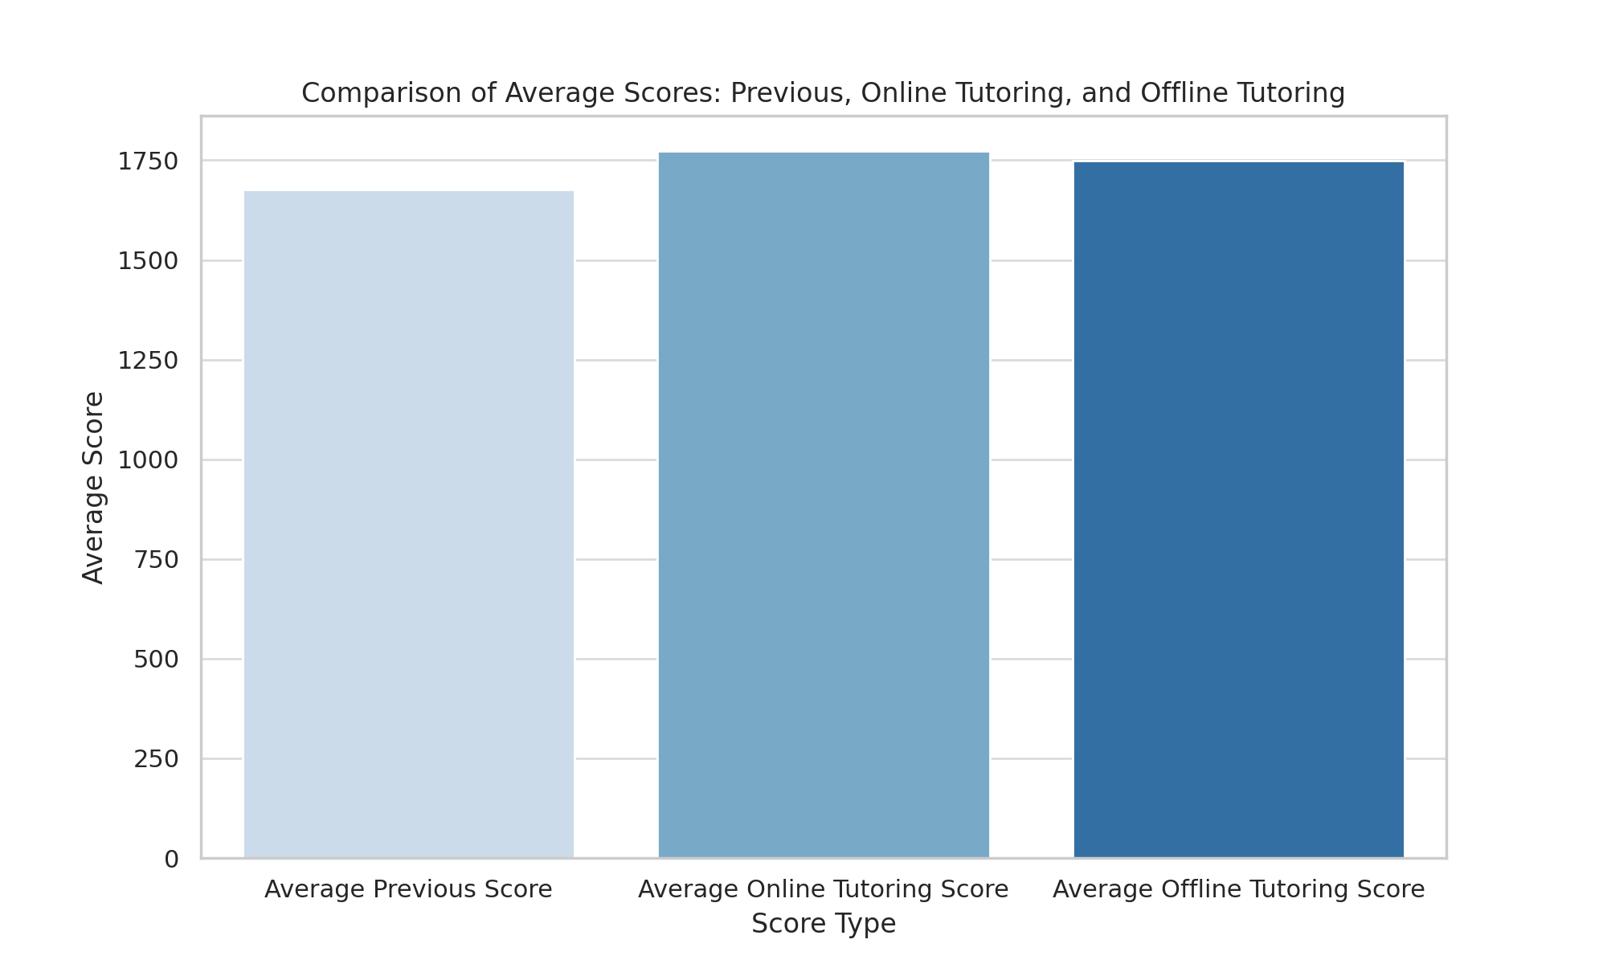
Business Impact
Learning from Past and Looking forward to the Future
Increase in Quality: Based on the evals data provided previously, we see tutoring online has had a larger impact on student’s total score. (Online Tutoring increased the score of a student by 70 points compared to only 40 points offline)
Offering a Premium Version: With this being a test, based on feedback and impact, we could potentially develop this further to add it as a separate program version
Leader: This would put Cobblestone Learning Center as the leader in adopting cutting-edge AI tools and revolutionizing the education industry
Potential for Operational Cost Reduction: Potentially reduce the hours of manual test preparation and tutoring where the hours spent could be in feeding knowledge to our Tutor bot.
The data contains average total cores of students before Tutoring and after tutoring (Online vs Offline)

Slide 15
Inside Features
Features | What are the features like?
Social Connectivity Tools | Facilitate networking and community building among users
Time Management Assistance | Integrate calendar management and scheduling reminders
Learning Resources | Provide a curated list of articles, tutorials, and guides
Interactive Q&A | Answer user questions with informative and supportive responses
Non-competitive Progress Tracking | Monitor learning progress in a way that doesn't emphasize competition
Customization Options | Allow users to tailor their learning experience to their personal preferences and styles

Slide 16
Recommendations
Target Segment Focus: Tailor the chatbot to the specific needs and learning styles, emphasizing structured and collaborative learning without competitive pressure
Business Objectives: Advance online learning with a GPT-based tutor chatbot, offer personalized experiences, adhere to ethical AI standards, and lead in educational innovation
Risk management: Develop strategies to handle technical risks, security and privacy concerns, and ensure user adoption and effective change management
Features and Impact: Incorporate features for social connectivity, time management assistance and non-competitive progress tracking to enhance the educational experience and potentially reduce operational costs

Slide 17
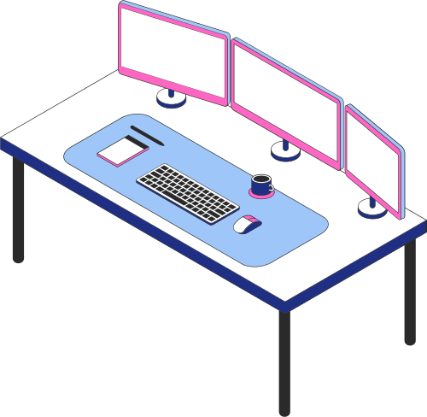
Do you have any questions?
Send it to us! We hope you
learned something new.

Slide 18
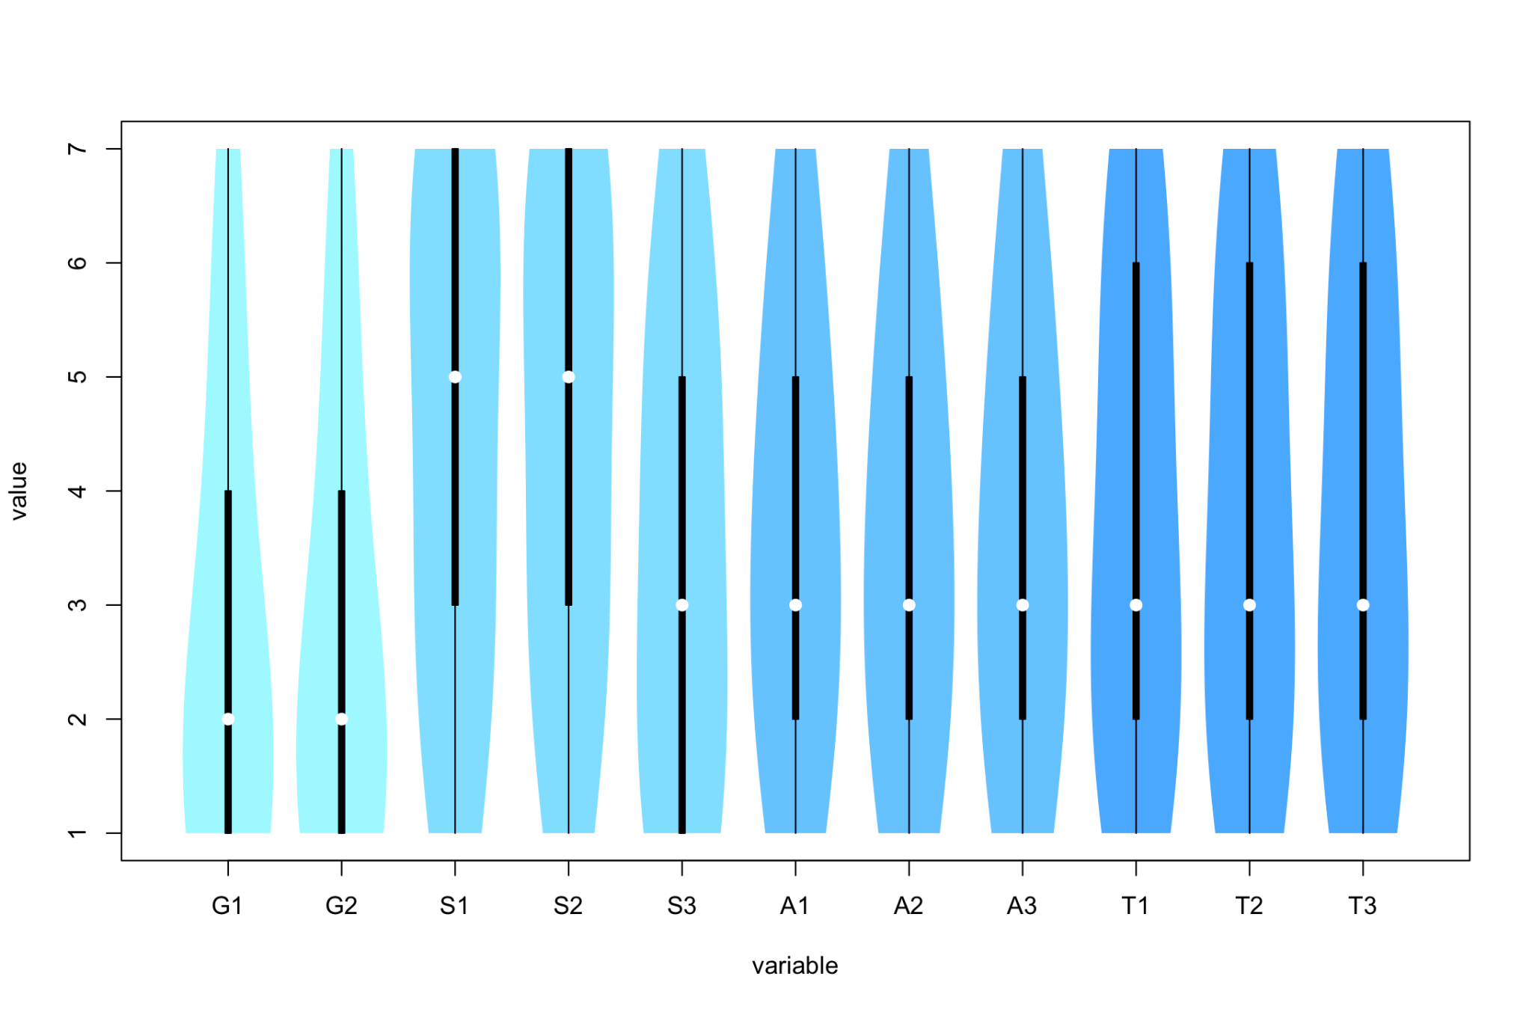
Appendix
Conclusions from the survey:
Students tend to not like competition or challenge.
They like to be accompanied during study, and find it engaging.
They do not necessarily need positive academic praise from teachers or classmates.
They show various perspectives towards learning time management skills. It is more likely to be unappealing.

Slide 19
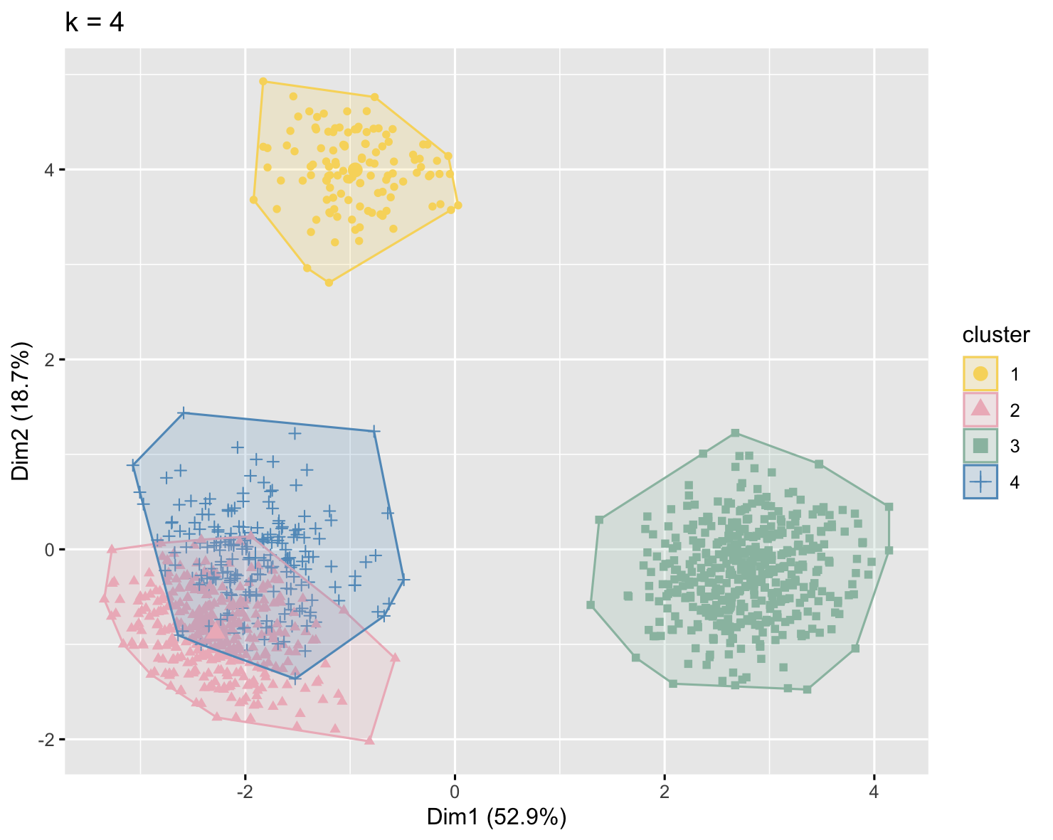
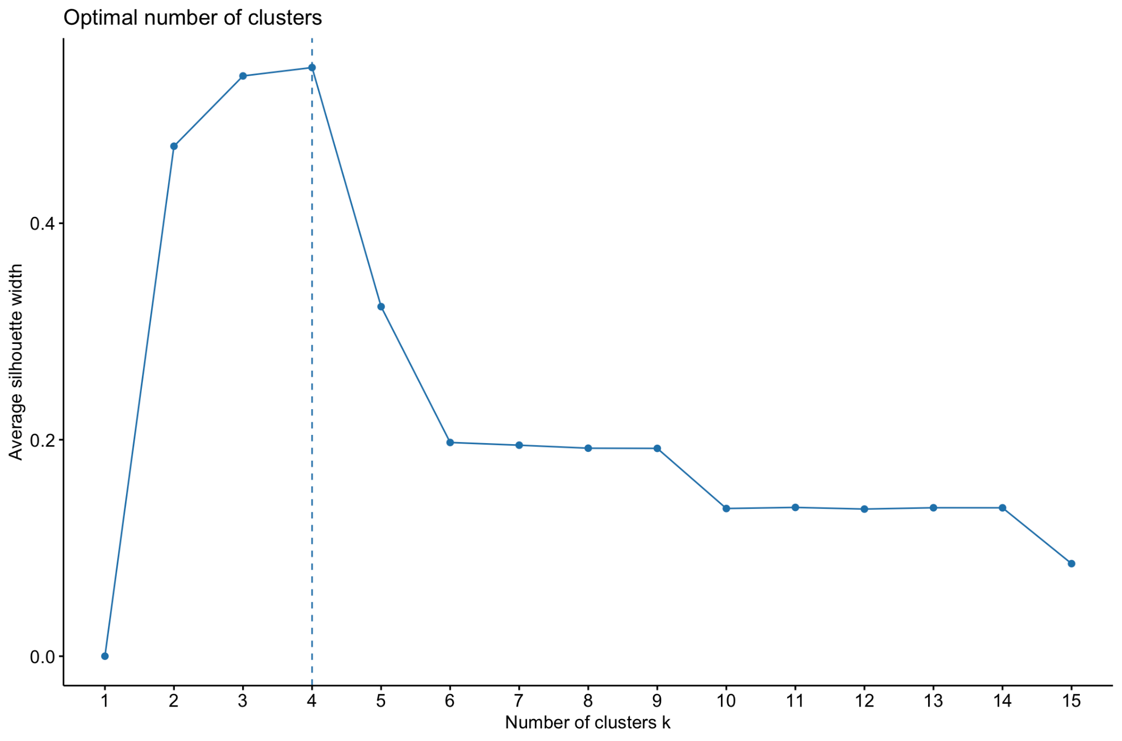
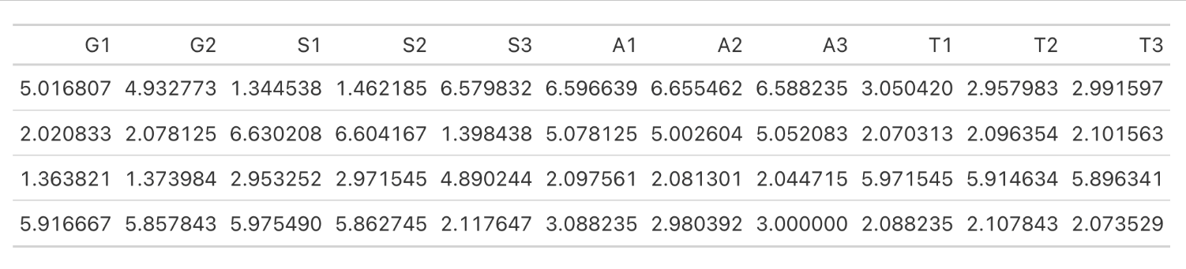

Slide 20
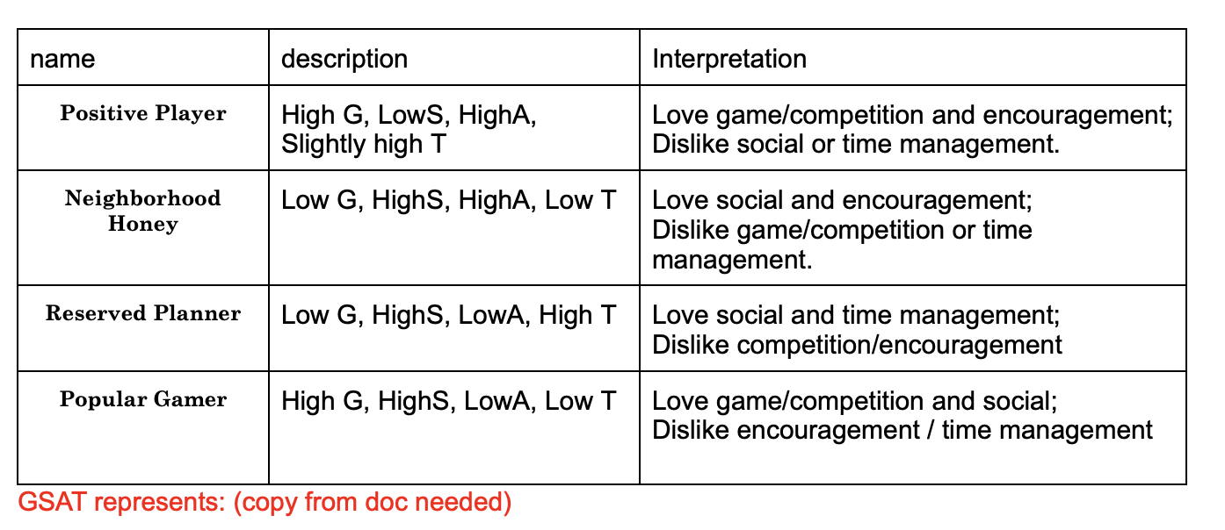
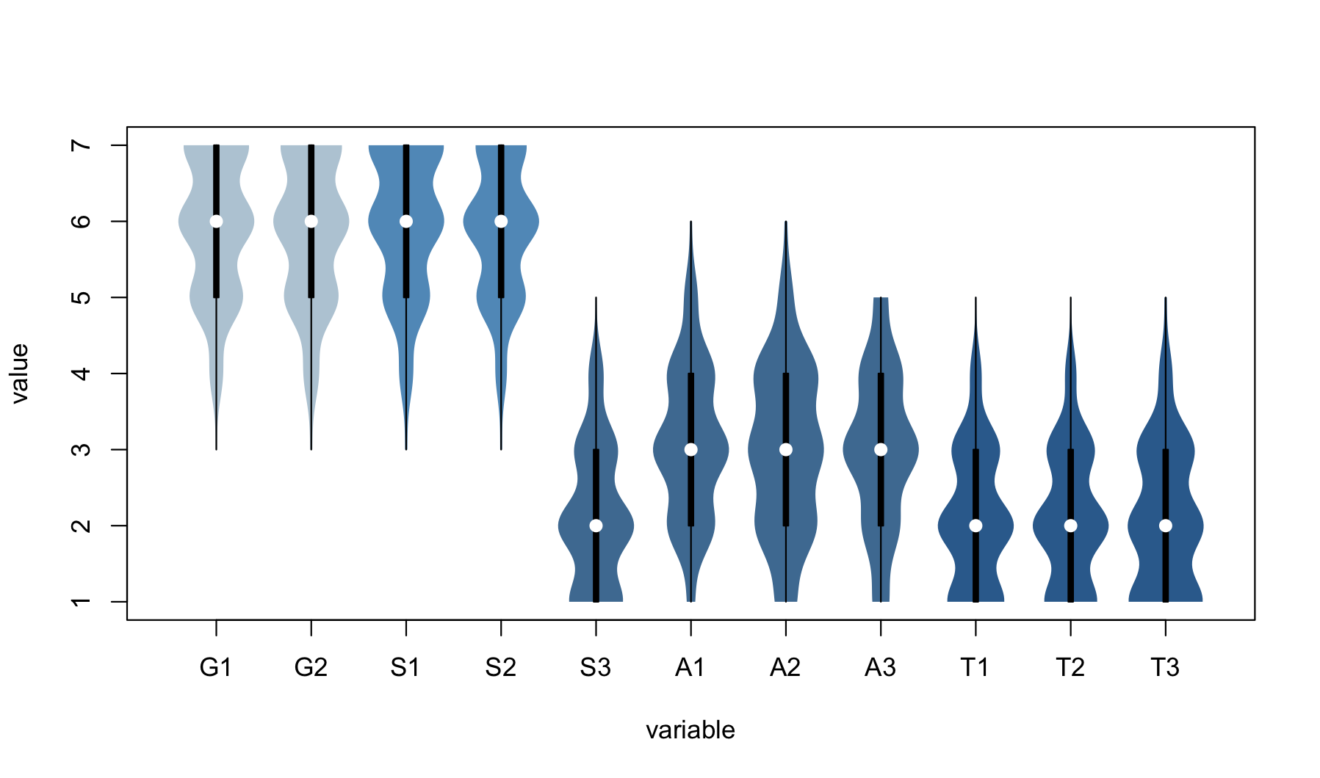
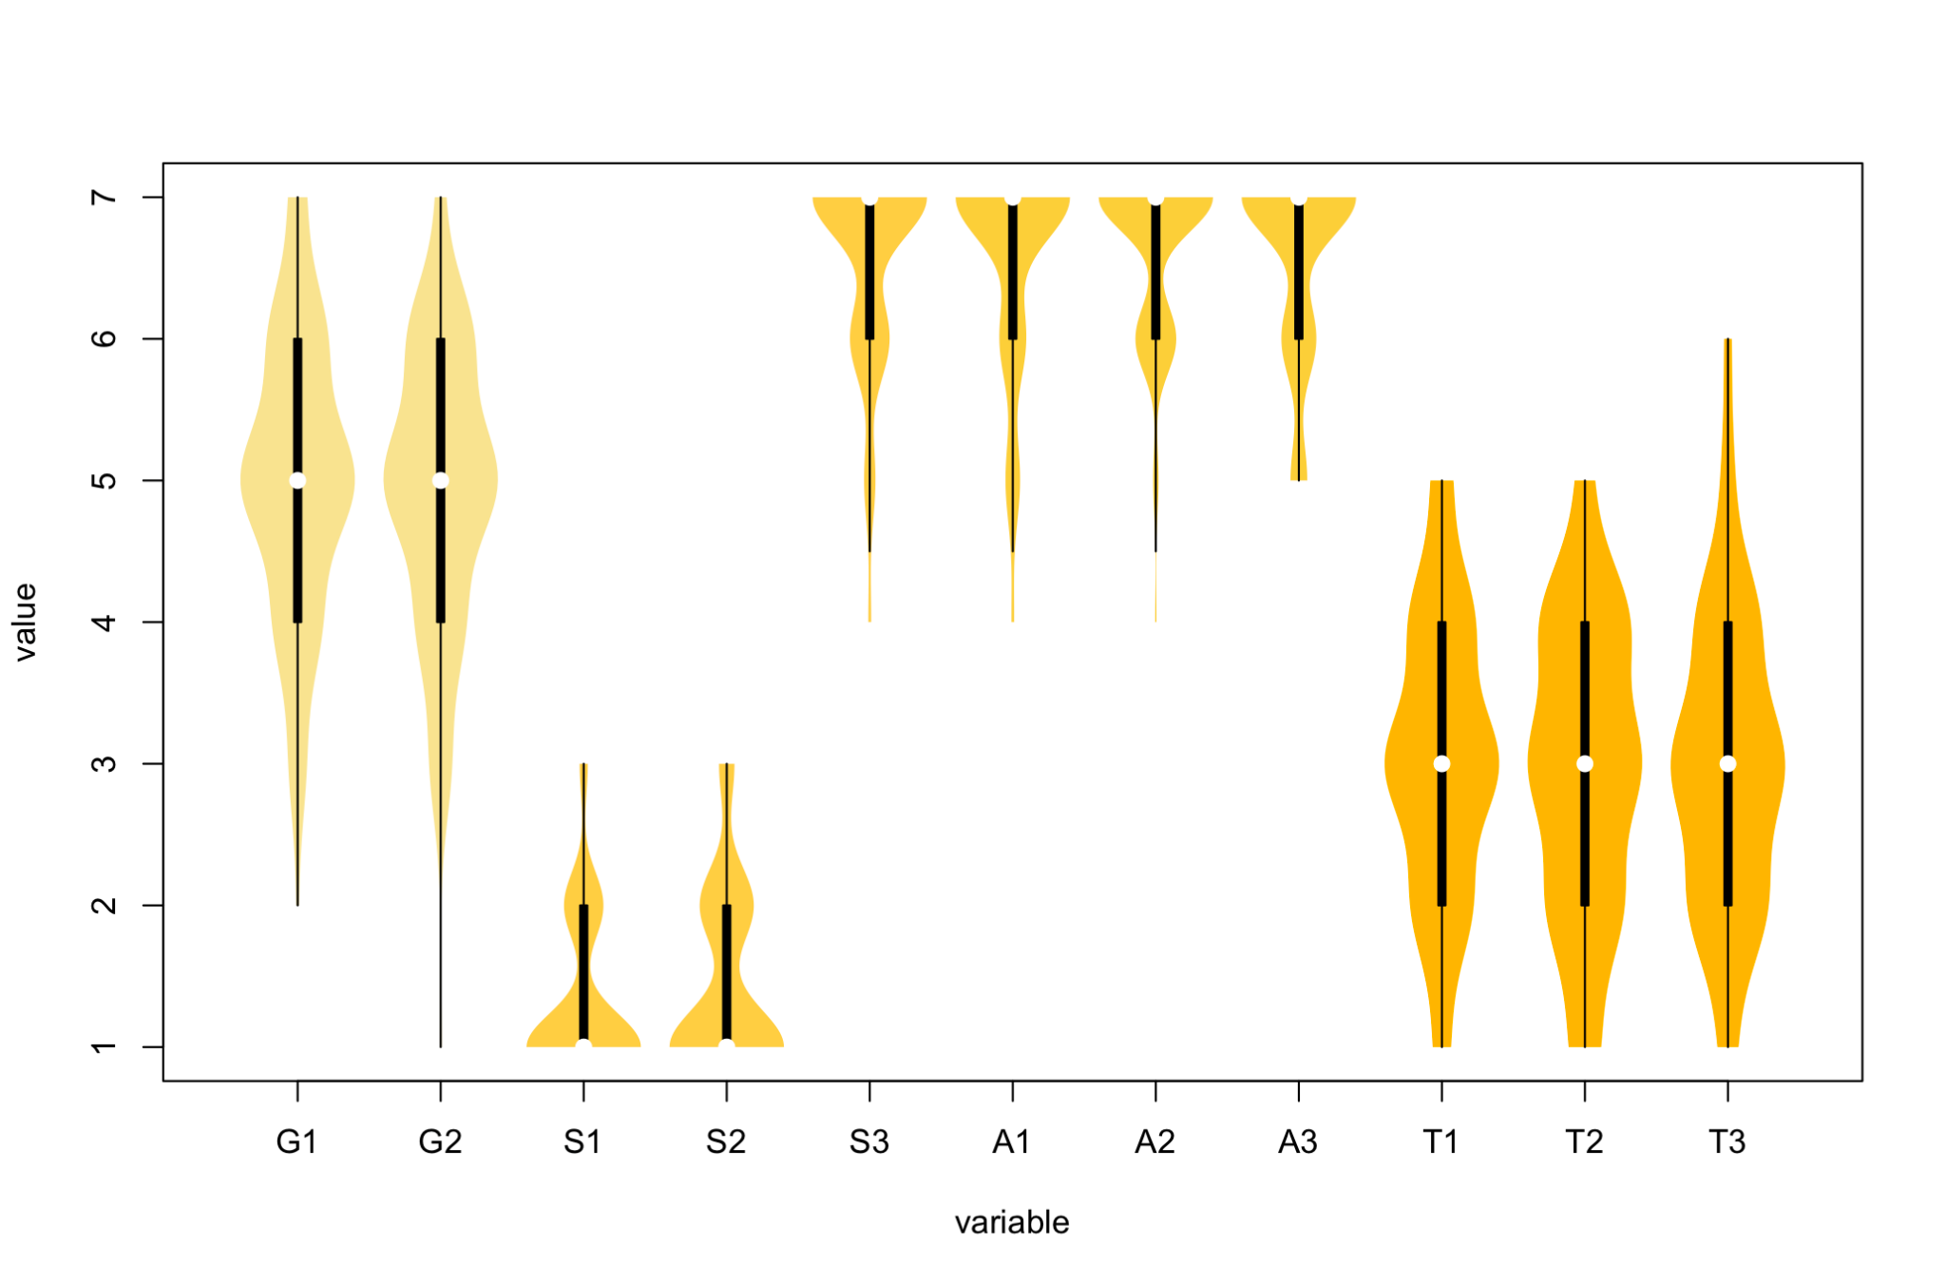
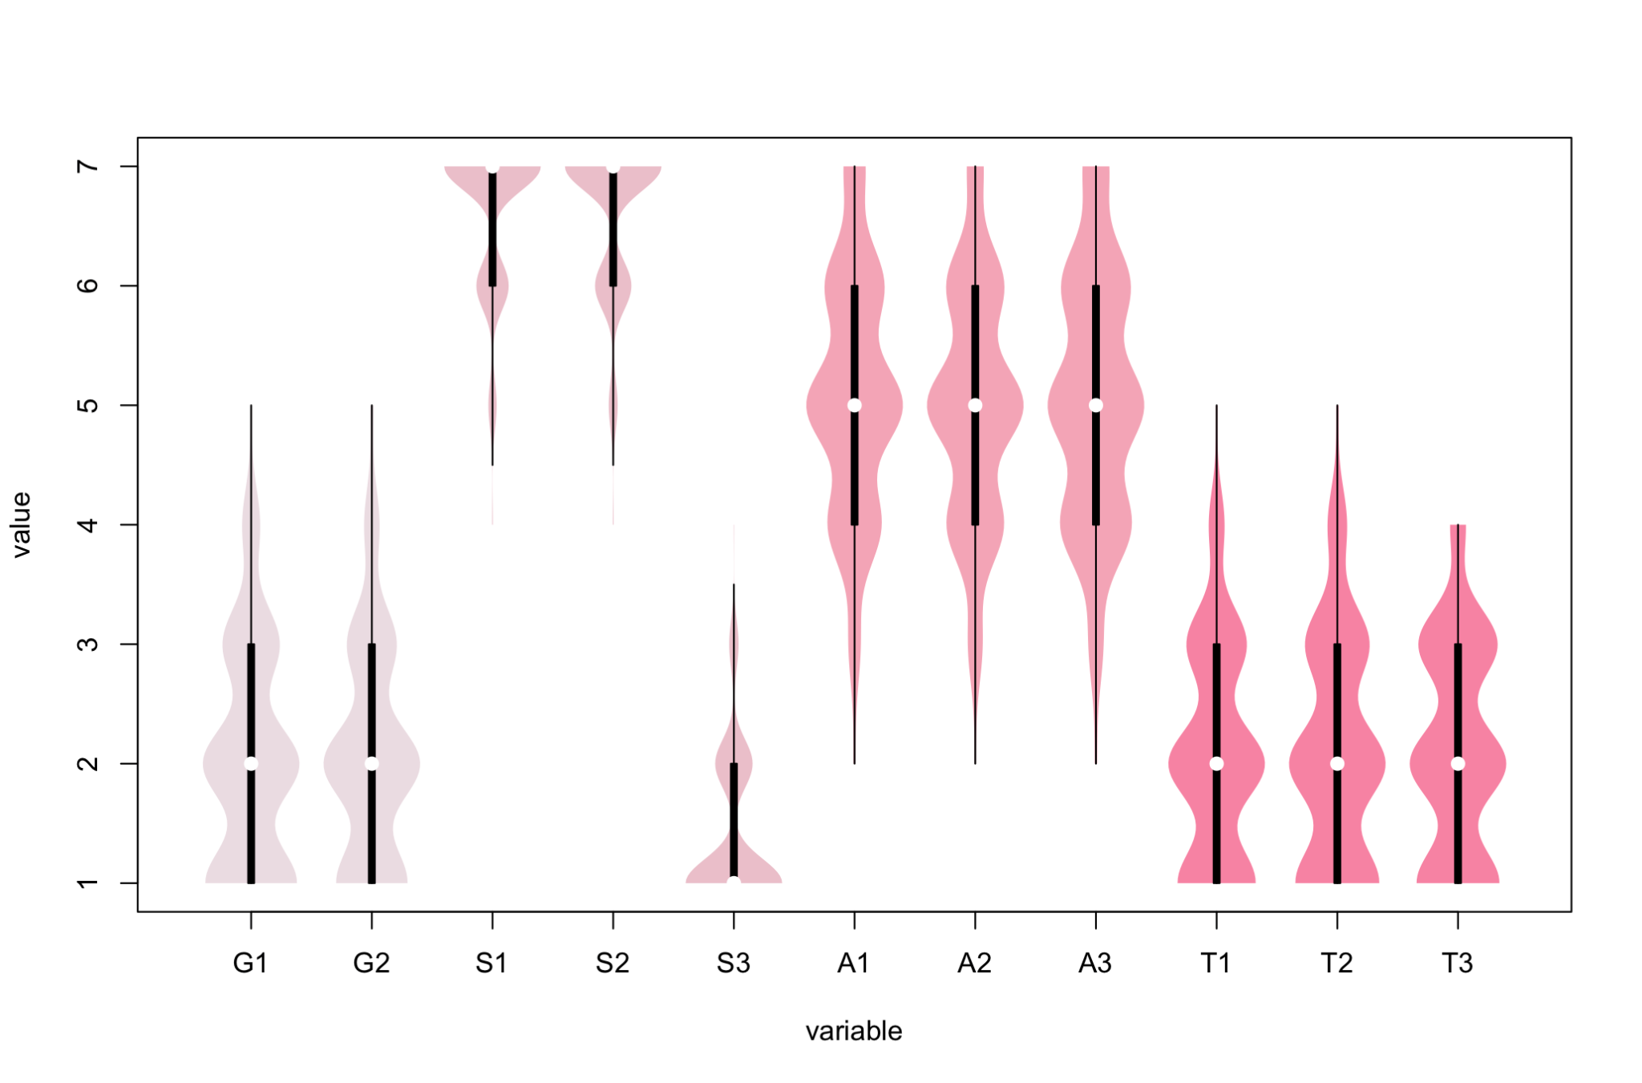
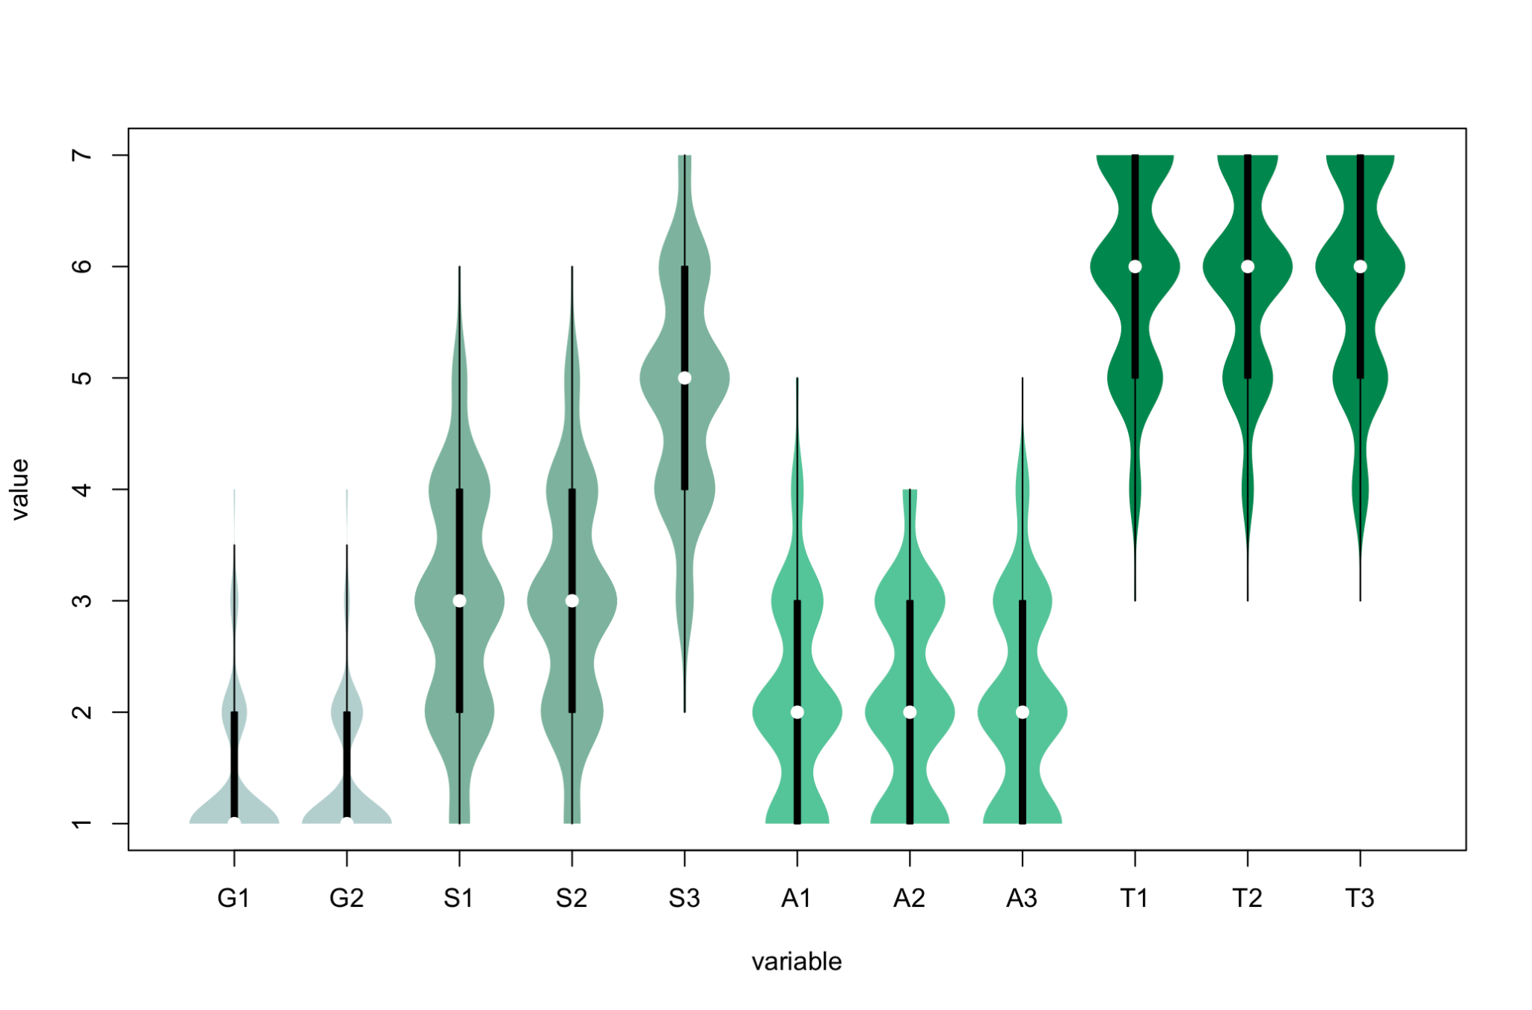
4
1
2
3

